Slide 1
QUANTUM COMPUTING 10 MIN TALK PRESENTAION
Prepared by: Ahmed Saad El Fiky

Slide 2
TABLE OF CONTENTS
RECENT PAPER
QUANTUM ALGORITHM
01
Henry M., Quantum Computing Applications for Flight Trajectory Optimization, Apr 27, 2023.
02
Quantum-enhanced Dijkstra’s algorithm for weighted DAGs, with parallelized weight update subroutine.
QUANTUM HARDWARE
QUANTUM SOFTWARE
Q-CTRL FIRE OPAL:
Finding TURE value from algorithms run on today's quantum processors with automated error suppression.
04
Xanadu X-8 Photonic Chip:
Quantum Programmable Nanophotonic chip powered by laser pulses.
03
New Way to Count Photons May Add Up to Better Quantum Computing, May 1, 2023, The Quantum Insider.
05
RECENT NEWS
06
RESOURCES
Papers and websites.

Slide 3
RECENT PAPER Henry M., Quantum Computing Applications for Flight Trajectory Optimization, Apr 27, 2023.
01
Major players in the global aerospace industry are shifting their focus toward achieving net carbon-neutral operations by 2050.
For achieving sustainability, the capacity of quantum computing can be used to tackle computational challenges associated with flight path optimization,

Slide 4
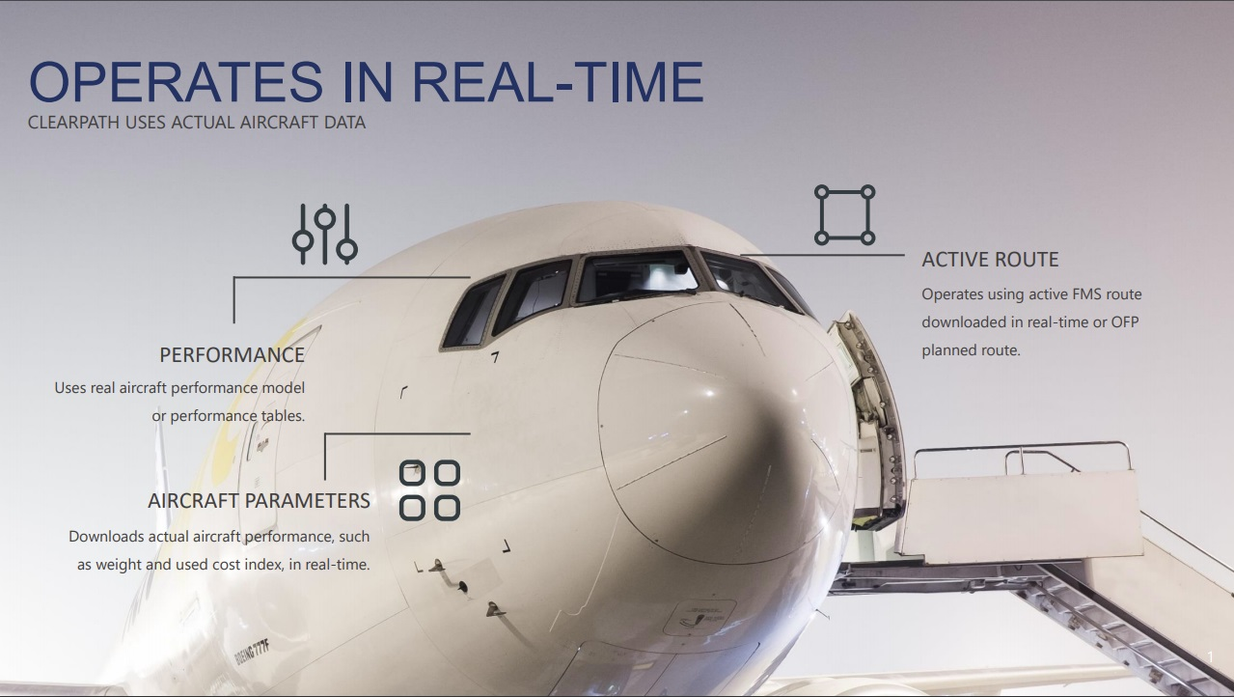
- Real-Time Constraint
“Flight optimization requires high computational power and fast algorithms capable of handling large amounts of data and providing solutions within a short time frame.”

Slide 5
Complexity and High Dimensionality
CONSTRAINT 1
CONSTRAINT 3
CONSTRAINT 5
Fuel Consumption
Aircraft Weight
Fluctuation in the Wind
CONSTRAINT 2
CONSTRAINT 4
Flight Time
Air Traffic Control Restrictions

Slide 6
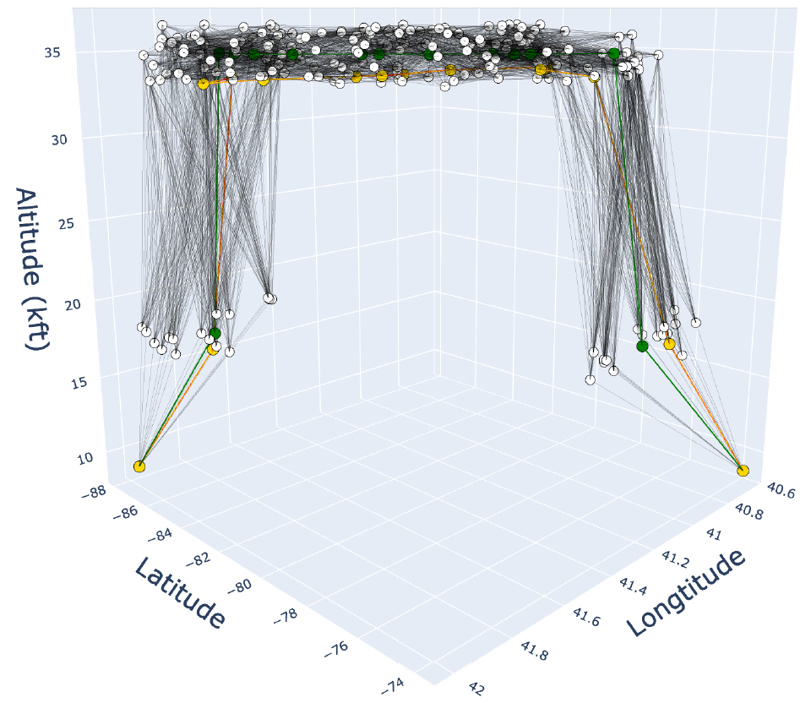

Flight Trajectory (Path) Optimization
3D Graph of the perturbed routes
SINGLE-SOURCE SHORTEST PATH Calculations:
Original Path.
Classical Dijkstra Path.
Quantum Dijkstra Path.
Directed Acyclic Graph (DAG)
Given a graph $G = (V;E)$, where $V$ is the set of vertices and $E$ is the set of edges with an associated edge weight function $w$, Dijkstra’s algorithm finds the shortest path between a given source, $s$, and a destination, $d$.

Slide 7

Quantum Algorithm Quantum-enhanced Dijkstra’s algorithm for weighted DAGs, with parallelized weight update subroutine.
02
The original implementation of Dijkstra’s algorithm used an array to implement the priority queue, resulting in a time complexity of $O(V2)$.
The most efficient implementation of Dijkstra’s algorithm uses the Fibonacci heap priority queue, which has a time complexity of $O(E +V log⁡V )$.

Slide 8



Quantum-enhanced Dijkstra’s algorithm
Minima finding on the unstructured list.
Updating weights of adjacent nodes in the priority queue.
The Dijkstra algorithm contains two subroutines that equally contribute to its $O(V2)$complexity:
Classical algorithm $O(V)$time.
Minima finding variation of Grover’s algorithm: Adaptation of Grover’s algorithm effectively exploits the quadratic speedup to enhance the efficiency of the minima-finding process $O(\sqrt{V})$time.
Classical algorithm $O(V)$time.
Can be parallelized using multithreading, allowing constant time per node.
The update step vanishes because its constant complexity is dominated by the minima finding terms.
Resulting in time complexity $O(\sqrt{V∗(L−1)})$ ; where $L$ is the number of original waypoints.

Slide 9
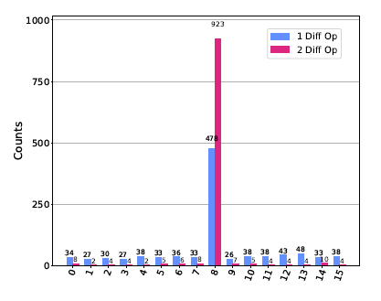
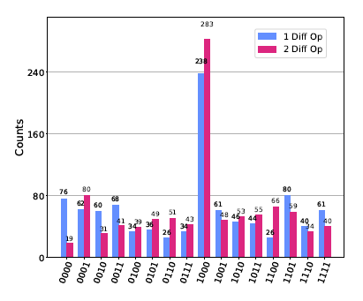
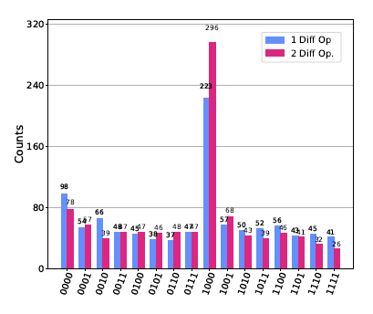
Benchmarking the Enhanced Algorithm on 3 different modalities.
IBM QASM Simulator
IBM Quito
Q-CTRL FIRE OPAL

Slide 10

Quantum Software Q-CTRL FIRE OPAL
03
An out-of-the-box solution that automatically reduces error and boosts algorithmic success on cloud-accessible quantum computers in the NISQ era and beyond.
Fire Opal packages a comprehensive suite of best-in-class AI-driven quantum control techniques into a simple tool.
Suppress errors in hardware and circuit execution with a single command.

Slide 11
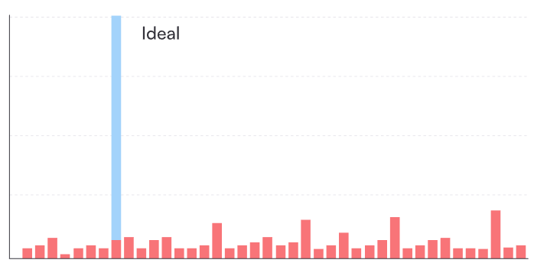
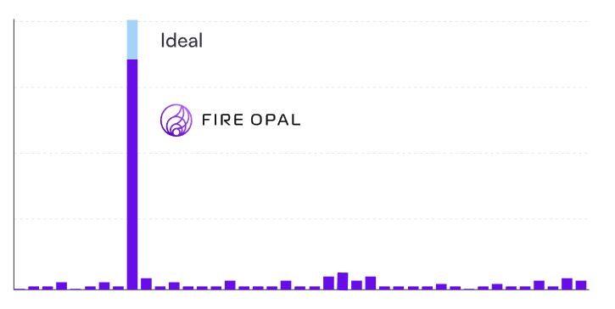

Q-CTRL FIRE OPAL
Save time and resources:
Run more valuable algorithms on today’s quantum computers by reducing errors automatically.
Transform outputs from random to useful.
Reduce compute costs by $>100x$and achieve superior performance with no extra circuit executions.
Eliminate hardware calibration and error-mitigation routines.

Slide 12
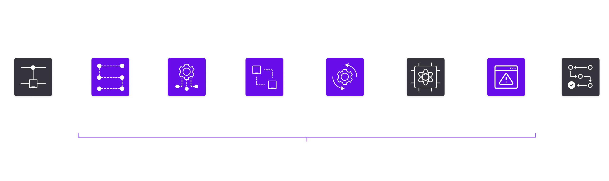
How it works
Fire Opal connects directly to supported hardware backends and returns the best output achievable without any user intervention, hardware knowledge or configuration required.

Slide 13
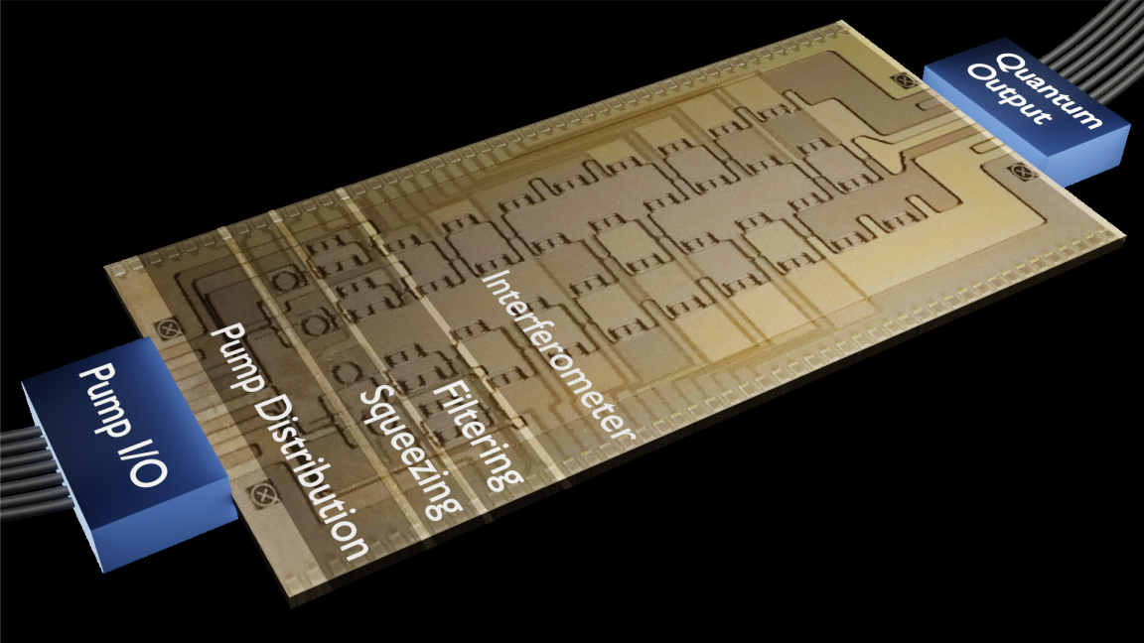
Quantum Hardware Xanadu X-8 Photonic Chip
04
Belong to X-Series device - Nanophotonic chip powered by laser pulses, manufactured by Xanadu Inc..
The first photonic quantum computers deployed to the cloud.
Consist of 8 modes separated into 4 spatial modes, each carrying two separate frequencies, 4 signal modes and 4 idler modes.

Slide 14
Quantum Hardware Xanadu X-8 Photonic Chip
The circuit architecture consists of the following components:
Firstly, two mode squeezing operations act on each pair of signal/idler modes. Squeezing can be turned on or off for a fixed squeezing level.
The second component of the circuit is a universal four-mode interferometer acting equally on signal and idler modes.
Finally, output modes are probed using transition-edge sensors (Photon detectors) capable of counting the number of photons.

Slide 15

Quantum Hardware Xanadu X-8 Photonic Chip

Slide 16
Latest News New Way to Count Photons May Add Up to Better Quantum Computing, May 1, 2023, The Quantum Insider.
05
Two researchers have developed a photon-number-resolving system to accurately resolve more than 100 photons at Jefferson Lab.
The team reports that it’s a step forward in capability for quantum computing development efforts, which may enable quantum generation of truly random numbers (QRNG).
No one had yet demonstrated detection of more than 16 photons.

Slide 17
RESOURCES
06
PAPARS:
Henry M., Quantum Computing Applications for Flight Trajectory Optimization, Apr 27, 2023.
Quantum circuits with many photons on a programmable nanophotonic chip, Mar 3, 2021.
Miller Eaton, Amr Hossameldin, Resolution of 100 photons and quantum generation of unbiased random numbers, Oct 28, 2022.
WEBSITES:
https://doi.org/10.48550/arXiv.2304.14445
https://q-ctrl.com/fire-opal
https://www.xanadu.ai/products/x-series
https://doi.org/10.1038/s41586-021-03202-1
https://doi.org/10.48550/arXiv.2205.01221
https://thequantuminsider.com/2023/05/01/new-way-to-count-photons-may-add-up-to-better-quantum-computing/

Slide 18
THANKS!
Do you have any questions?

